Slide 1


Predicting Air Quality
Using GRU Networks for Environmental Forecasting
A comprehensive exploration of deep learning approaches to forecast air quality and protect public health.

Slide 2

The Air Pollution Crisis
Air pollution has escalated since the Industrial Revolution. Today, it's a leading environmental risk factor for human health, contributing to morbidity, mortality, and reduced quality of life.
Health Impact
Primary Pollutants
7 million premature deaths annually attributed to air pollution, per WHO.
PM2.5, PM10, NO₂, CO, SO₂, O₃ penetrate lungs and bloodstream.
Societal Costs
Respiratory disease, neurological impairment, reduced productivity, economic losses.

Slide 3

Understanding the Air Quality Index
AQI consolidates multiple pollutant readings into a single metric, categorizing air quality from Good to Hazardous. It's used globally for public health advisories and policy-making.
Public Health
Urban Planning
Enables citizens to avoid outdoor exposure during high pollution periods and protects vulnerable groups.
Authorities enforce traffic restrictions, industrial regulations, and emission control strategies.
Scientific Value
Supports long-term strategies for air quality improvement and environmental research.

Slide 4
About the dataset
The dataset used in the study spans from 1 January 2021 to 31 December 2023 and was collected from Xitun District, Taichung City, Taiwan. It includes daily-averaged air quality index (AQI) values and 18 environmental variables such as PM2.5, PM10, NO₂, CO, O₃, temperature, humidity, and wind speed. The data was preprocessed using linear interpolation for missing values and normalized using Min-Max and Z-score methods. Gray Relational Analysis revealed RAINFALL (0.85), NO (0.81), and PM2.5 (0.81) as the most influential variables on AQI. The dataset was split 80:20 for training and testing, ensuring robust model evaluation

Slide 5
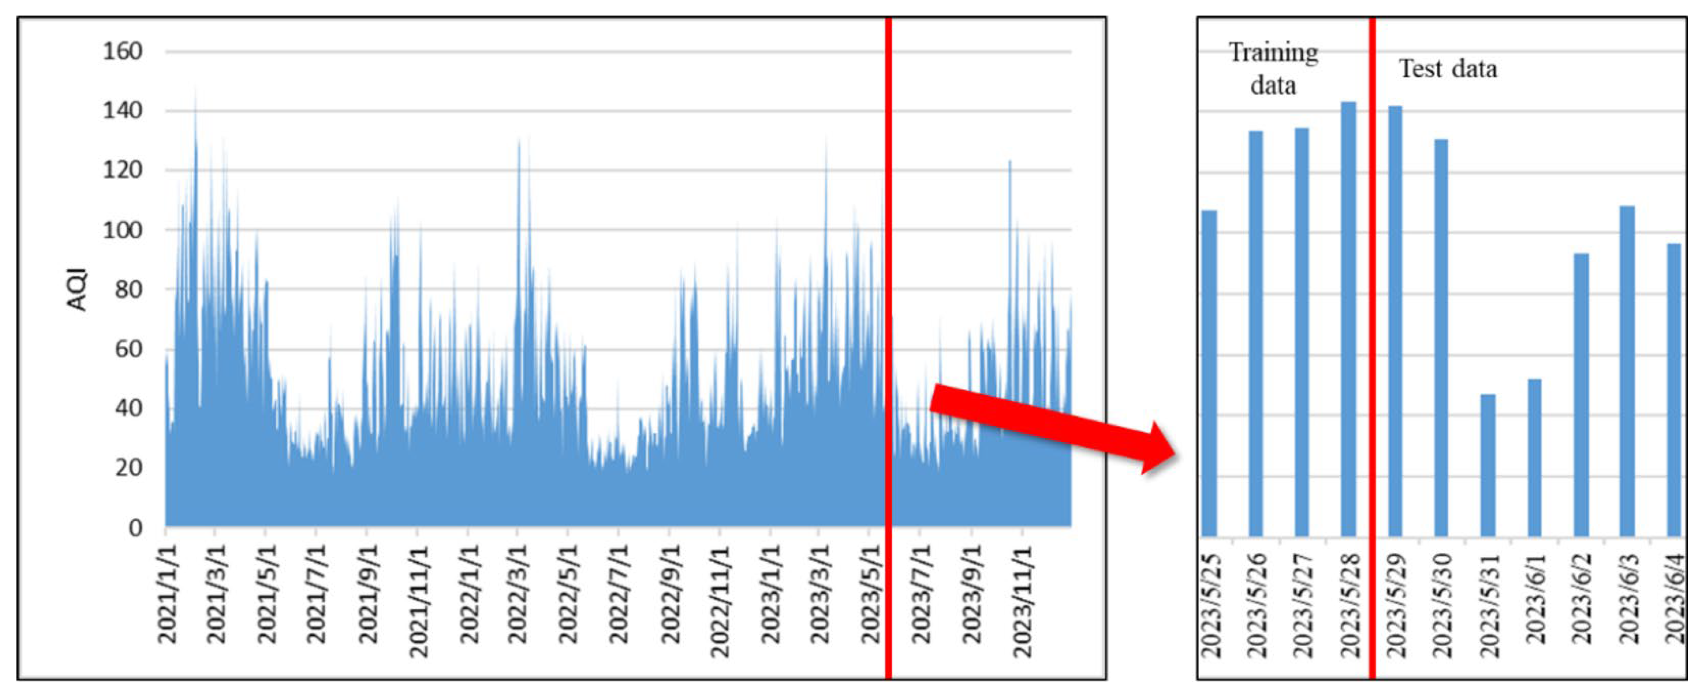

Slide 6
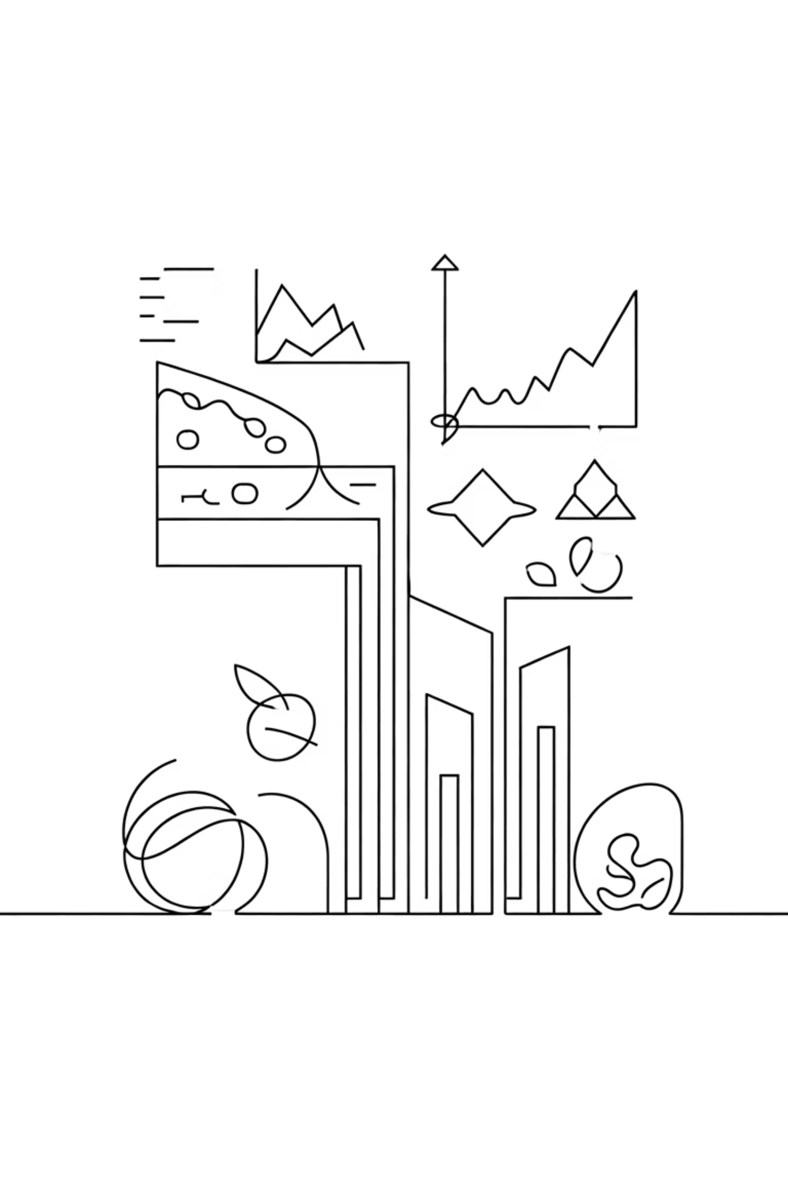
The Prediction Challenge
Developing accurate AQI forecasts requires handling temporal dependencies, multivariate relationships, seasonal variations, event-driven spikes, and data quality issues.
1
Temporal Dependencies
AQI depends on historical pollutant trends and weather patterns over time.
2
Multivariate Interactions
Pollutants and weather variables interact non-linearly and unpredictably.
3
Seasonal Variations
Pollution patterns change with seasons and time of day, requiring adaptive models.

Slide 7
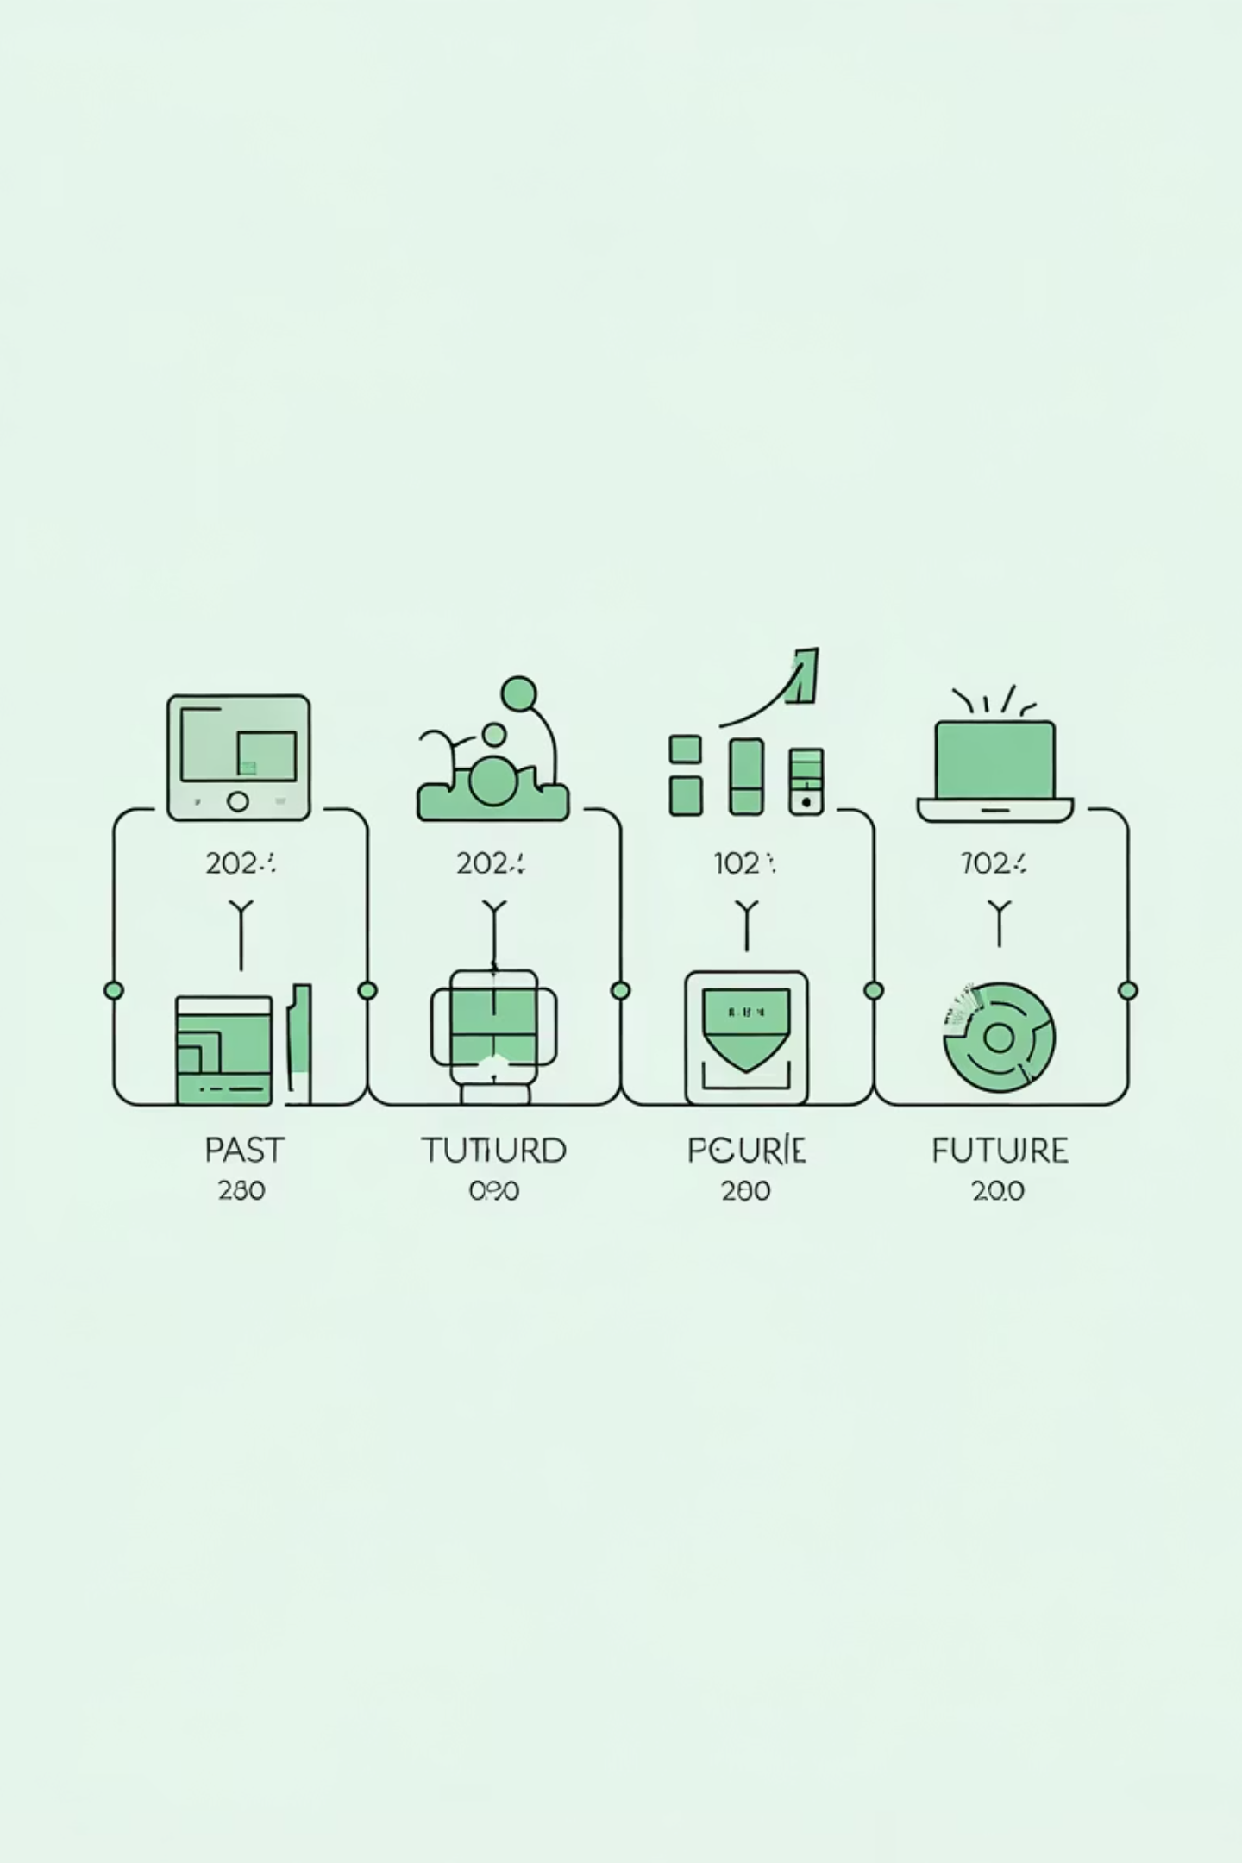
Evolution of Prediction Methods
From traditional statistical models to modern deep learning, each approach offers distinct advantages and limitations for AQI forecasting.
1
ARIMA & Linear Regression
Simple, interpretable; cannot model non-linear patterns.
2
Machine Learning
SVR, Random Forest capture non-linearity; lack temporal sequence modeling.
3
RNN & LSTM
Model sequences; LSTM computationally heavy with many parameters.
4
GRU Networks
Efficient, fewer parameters, captures long and short-term dependencies.

Slide 8



GRU Architecture for AQI Prediction
Gated Recurrent Units balance performance and computational efficiency through update gates, reset gates, and candidate hidden states that learn temporal patterns.
Input Layer
Multivariate data: PM2.5, PM10, NO₂, CO, SO₂, O₃, temperature, humidity, wind speed, pressure.
GRU Layers
32–64 neurons per layer with 10–20% dropout to prevent overfitting.
Dense Layer
Fully connected layer processes hidden states.
Output
Single neuron predicts next AQI value.

Slide 9
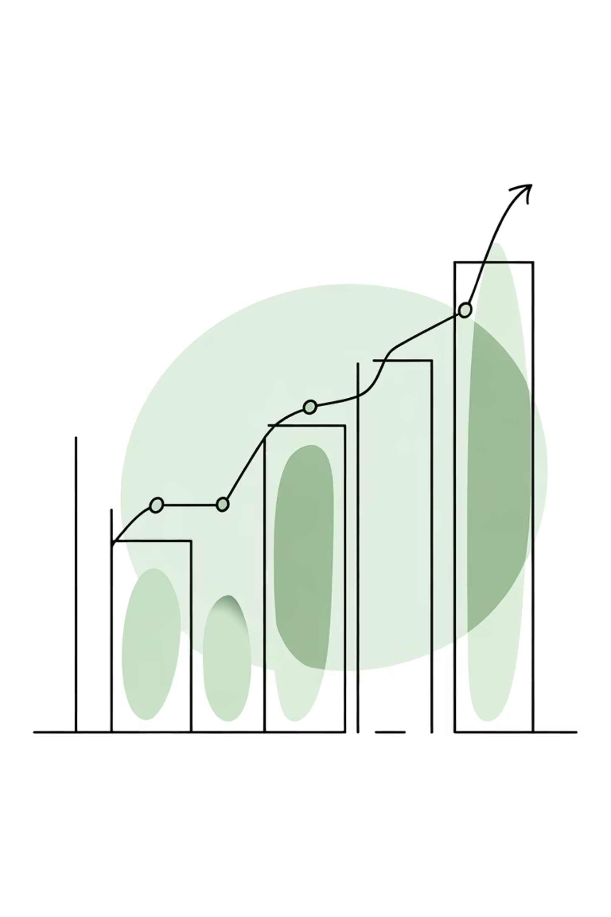
Training and Evaluation
Rigorous data preparation, model training with Adam optimizer, and comprehensive evaluation metrics ensure robust AQI predictions.
Data Preparation
Evaluation Metrics
Handle missing values and outliers
Mean Squared Error (MSE)
Root Mean Squared Error (RMSE)
Normalize features (Min-Max scaling)
Mean Absolute Error (MAE)
Create sequences using sliding window
R² Score for model fit quality
Split: 70% train, 15% validation, 15% test

Slide 10
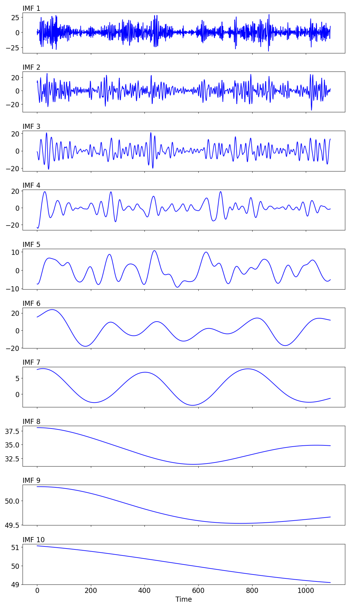
Result
AQI time series decomposed into 10 intrinsic mode functions (IMFs) and a residual using EEMD

Slide 11
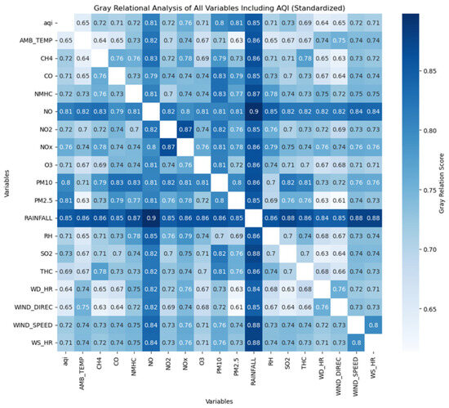
Gray correlation analysis diagram.

Slide 12

Limitations and Ethical Considerations
GRU models face challenges with data quality, extreme events, and interpretability. Ethical deployment requires accuracy, transparency, fairness, and privacy safeguards for vulnerable populations.
Data Dependency
Extreme Events
Performance depends on sensor accuracy; missing data degrades predictions.
Sudden spikes from festivals or industrial accidents may not be captured.
Black Box Problem
Equity Concerns
Deep learning lacks interpretability; difficult to explain individual predictions.
Urban areas with dense sensors get better accuracy; rural regions suffer from bias.

Slide 13












Future Innovations
Advanced architectures, multi-city models, real-time IoT integration, and explainable AI will enhance AQI prediction accuracy and societal impact.
Satellite Data
Attention Mechanisms
Remote sensing enables spatial AQI prediction over large geographic areas.
Highlight key features and time steps influencing AQI predictions.
Explainable AI
Hybrid Models
Feature attribution techniques build trust with policymakers and the public.
CNN + GRU captures spatial correlations and temporal dependencies.
Real-Time Systems
Transformers
IoT-enabled networks with mobile app integration for personalized health recommendations.
Handle longer sequences efficiently for improved long-term forecasting.

Slide 14

Key Takeaways
GRU networks offer an efficient, powerful solution for AQI prediction. Accurate forecasts empower citizens and policymakers to make informed decisions, protect vulnerable populations, and guide sustainable urban development.
Computational Efficiency
GRU balances performance with fewer parameters than LSTM.
Temporal Learning
Captures complex non-linear interactions in multivariate environmental data.
Public Health Impact
Enables proactive health advisories and protective measures for at-risk groups.
Responsible Deployment
Ethical frameworks ensure accuracy, transparency, fairness, and privacy protection.

